Slide 1
Enterprise Customer Neo4j Graph Database CDI Master File Load
Presentation and Code can be found at: https://github.kdc.capitalone.com/ghl336/neo4j

Slide 2


About me
Name : Bin Cao
University : Georgia Tech
Degree : BS Computer Science
Graduation Date : May 2016
Fun Fact: I like cooking!
C1 Teams : Enterprise Architecture, EDS - Enterprise Customer
Project Objective : Load CDI master file into Neo4j using Java and explore potential use case of graph database.

Slide 3
What is a graph database?
Nodes (objects of interest)
Edges (relationships between nodes)
Properties (attributes represented as key-value pairs)
advises
Person
Name:Randy
Role:Architect
Person
Name:Bin
Role:Developer
supported by
owned by
architects
Project
Name:Neo4J
owns
Notes:
Minor changes

Slide 4



The project objective is to load CDI master file into Neo4j graph database using Java
Neo4j is an open-source NoSQL graph database implemented in Java and Scala. It is a leading graph database used by many companies and organizations, such as LinkedIn.
Neo4j offers multiple integration solutions for Java developers. We used JAVA API, batch insert and REST API plugin to load CDI master file to create nodes and edges. Also tested Cypher query for reading the data in database.
Customer Data Integration (CDI) Master File is the holistic enterprise view of the customer and account relationships belonging to a person or business. The file contains identity, contact points, households identifier and other key customer data.

Slide 5
CDI Graph Data Model
Address
adr_line: 3922 BARLEYTON CIR
city_nm: SYLVANIA
st_cd: OH
pstl_cd: 380193048
cntry_cd: USA
Email
hasMailAddress
email_adr: ads@gmail.com
hasEmail
Customer
hasPhyAddress
Address
sor_id: 02
sor_cust_id: 4617831
grp_cd: ID
full_nm: Bryan S Friess
frst_nm: Bryan
mid_nm: S
last_nm: Friess
tax_idn: 299667993
lang_cd: ENG
brth_dt: 19750524
legl_afil_id: 102
ent_cust_id: 99101856043
adr_line: 624 Tom’s Street
city_nm: Los Angeles
st_cd: LA
pstl_cd: 90210
cntry_cd: USA
hasMobilePhone
Phone
hasRoleOn
Phone: (786)5294876
hasHomePhone
Account
isPartOf
sor_id: 02
acct_id: 6206217185069
acct_stat_cd: CH
sor_acct_stat_cd: D
acct_open_dt: 20011219
prod_cd: AL
acct_type_cd: Domestic
prft_ctr_cd: TSYS
Phone
hasWorkPhone
Phone: (304)5294876
Household
Phone
id: 236234047
Phone: (202)5294876

Slide 6
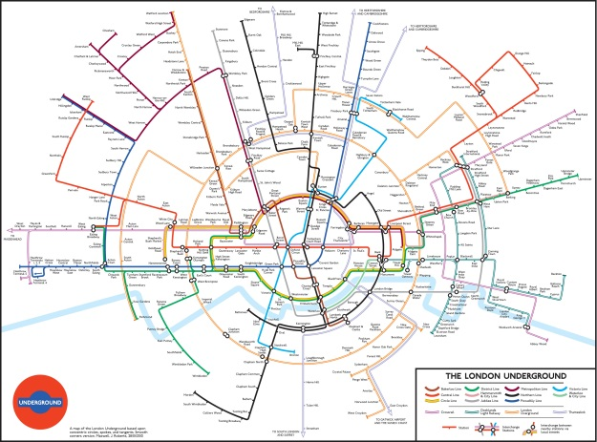


Graph Databases use cases provide insights about relationships which are difficult to produce with traditional relational databases
Designed data store to support analytical insights
Recommendation engines for “next best” servicing action, target marketing offer and best travel route
720-degree view of customer
Master data management
Fraud detection and risk analysis
Visualization of customer data to aid in pattern generation
Optimization of search

Slide 7
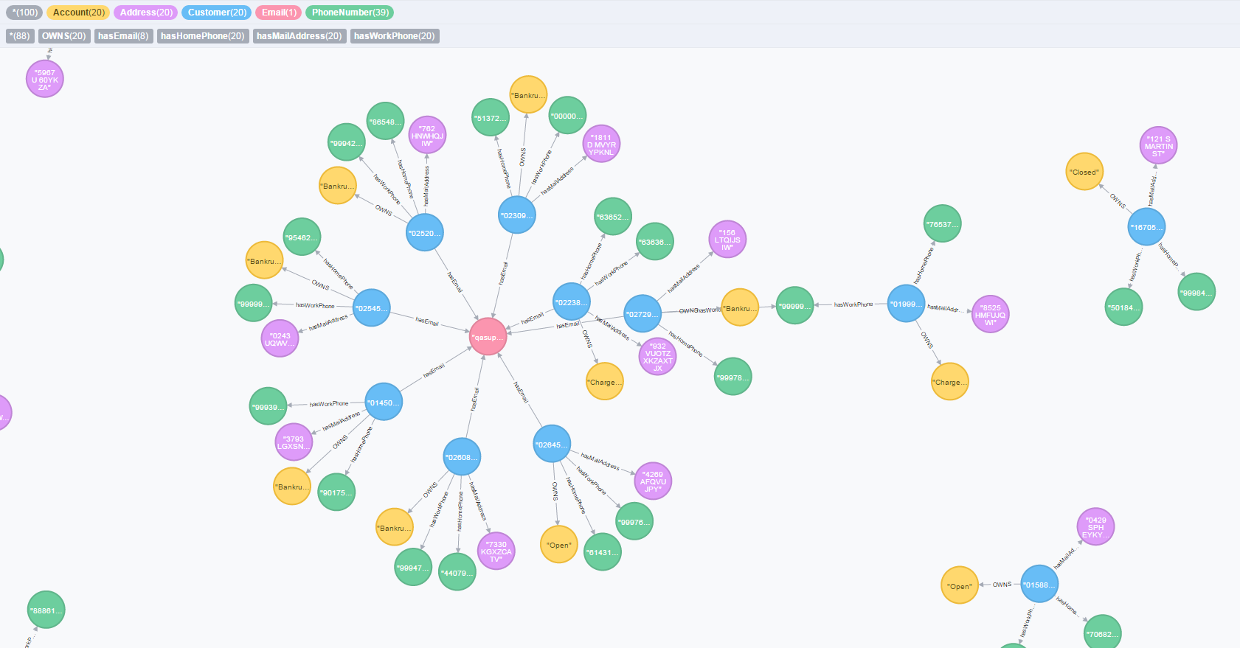
Live Demo

Slide 8
Significant progress was made in the development of Neo4J load of CDI Master File with identification of Java best practices
Built desktop development environment and with Java and Neo4J and AWS application server
Analyzed CDI Master File to identify nodes, edges and properties
Evaluated the different DB access methods Java API vs. Cypher
Built initial load program and tested with scrubbed data of 600,000 records. This resulted in approximately 1.4 million nodes and 3 million relationships. Runtime was approximately 2 days.
Used Java maps instead of strings to reduce runtime to 16 hours
Implemented REST API plugin use batch insert based on recommendation of Neo4J Sales Engineer to reduce runtime to 10 minutes
Changed Neo4J configuration to increase RAM further reduce to 6 minutes
Loaded data to Neo4J to AWS sandbox server, runtime is less than 3 Minutes. Estimated actual production load for 180 million CDI records with 2 billion nodes. It will run for estimated 15 hours.
Explored potential user interfaces other than Neo4J browser including Popoto.js and Alchemy.js

Slide 9
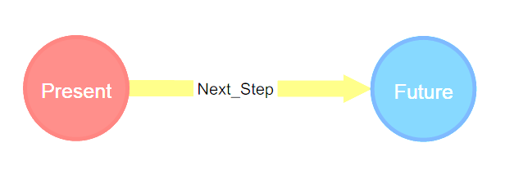
Next Steps for production use as an analytically designed data store for use in sandboxes and production applications
Load full CDI Master File
Develop delta processing solution
Add customer-related nodes and relationships from:
Other customer management applications
Social media
Transactions
Finalize security architecture for production deployment
Establish commercial license for Enterprise Edition and support model
Build AWS Neo4J Enterprise Edition production infrastructure
Develop user interface solutions and services driven by use cases

Slide 10





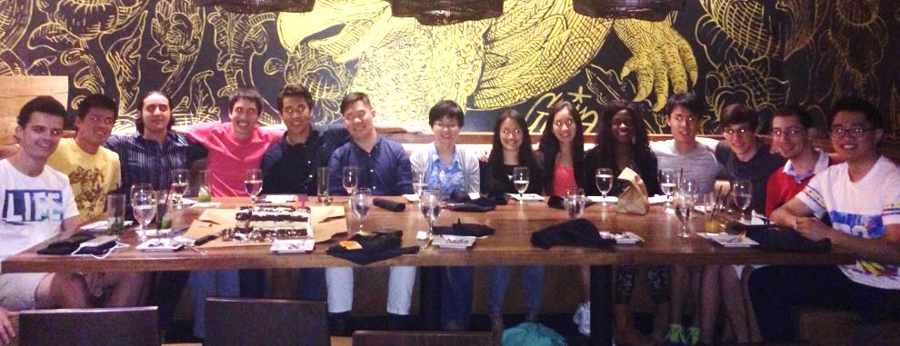


Slide 11
Significant progress was made in the reducing of load time of CDI Master File

